Slide 1
Bringing the Analog World to Digital Design
Team member:
Conor Naughton
Bin Xu
Yimin Xu

Slide 2
Goal/Motivation
Explore the use of analog signals
Exchange a digital input for a game with an analog input
Store ADC data
Pull data from memory
FPGAs work with digital signals however the tasks they are used for often involves analog inputs
Analog is more interesting than digital
Requires interacting with and controlling another component of the development board (Analog to Digital Converter (ADC))

Slide 3
Short Functionality
Describe game, rules
Balloons speed up after certain number of points
Additional balloons coming in

Slide 4
Short Specification

Slide 5
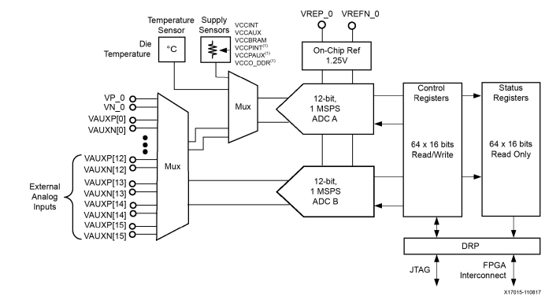
Detailed Functionality-ADC [Conor]
How does ADC sampling work?
System clock needs to be kept at 18 times sample frequency
Sample rate 1MSPS
12 bit ADC
4096 quantization levels
General-purpose, high-precision analog interface for a range of applications
Unipolar and differential measurement
Status registers: where conversion data is stored
Conversion data accessible through a 16-bit synchronous read and write port called the dynamic reconfiguration port (DRP)
Also accessible though JTAG TAP
What does the ADC output mean?
Make it clear which block we are in (visual in top corner)

Slide 6
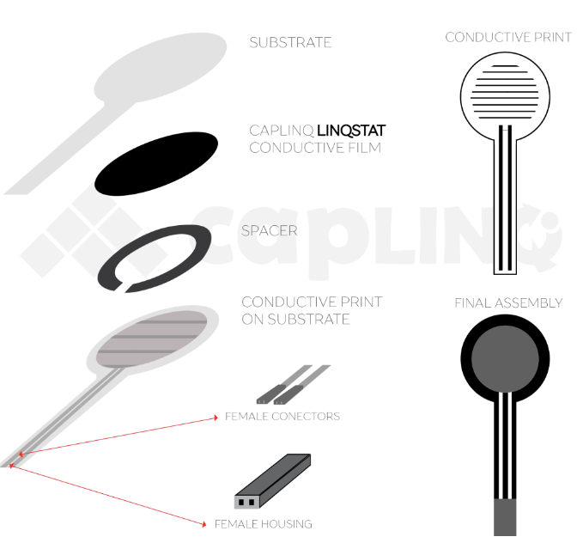
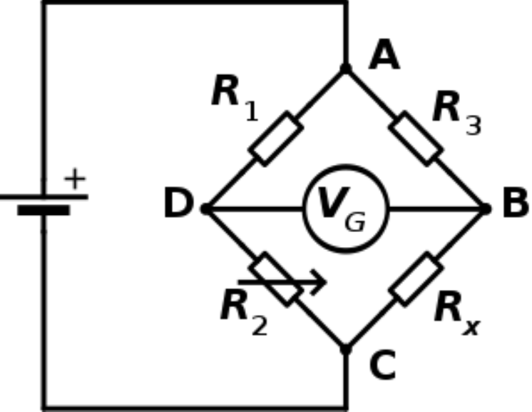
Detailed Functionality-Force Sensitive Resistor [Conor]
FSR is a material which changes its resistance when a force or pressure is applied.
Composed by two substrate layers sandwiching together a conductive film and a spacer.
The substrate layer which is on the spacer side also has a conductive ink printed on it.
When force is applied to the sensor, the conductive film is deformed against the substrate and air is pushed out of the spacer causing the conductive film to come into contact with the conductive print on the substrate. The more of the conductive ink area touching the conductive film, the lower the resistance.

Slide 7
Detailed Functionality-Game [Bin]
How did we change the game?
How do we use the output of the ADC

Slide 8
Detailed Functionality-Memory [Yimin]
What were we planning on doing with the memory?
Why didn’t it work?
How does Quad SPI flash work?
What did we end up doing instead?

Slide 9
Detailed Block Diagram [Bin]

Slide 10
Verilog Example [Conor]
ADC instantiation
Explain DRP connection
Annotate code with simple comments of functionality

Slide 11
Successes
Analog game
Pressing harder makes it move faster
Attribution of successes

Slide 12
Failures
Use of Quad SPI flash memory
Timing issues of direction change versus ADC settling
Explain what we tried for each of these

Slide 13
References

Slide 14
From update presentation

Slide 15
Path Forward
Game Code Base [Bin Xu]
Change out button input for ADC output [11/11]
Start with simple threshold and maintain single step of paddle
Change from single step to step proportional to ADC output [11/18]
ADC [Conor N]
Figure out how to make measurements more differentiable [11/4]
Likely replace with a load cell but in the mean time, try to find an EE solution
Characterize measurement repeatability, fidelity [11/9]
Finalize gameplay setup and demonstrate functionality [11/18]
Quad SPI Flash [Yimin Xu]
Combine the flash controller into game memory

Slide 16
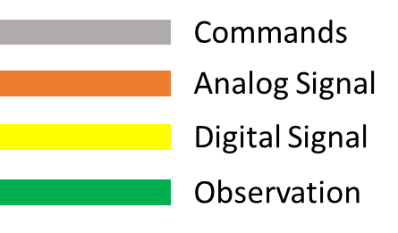
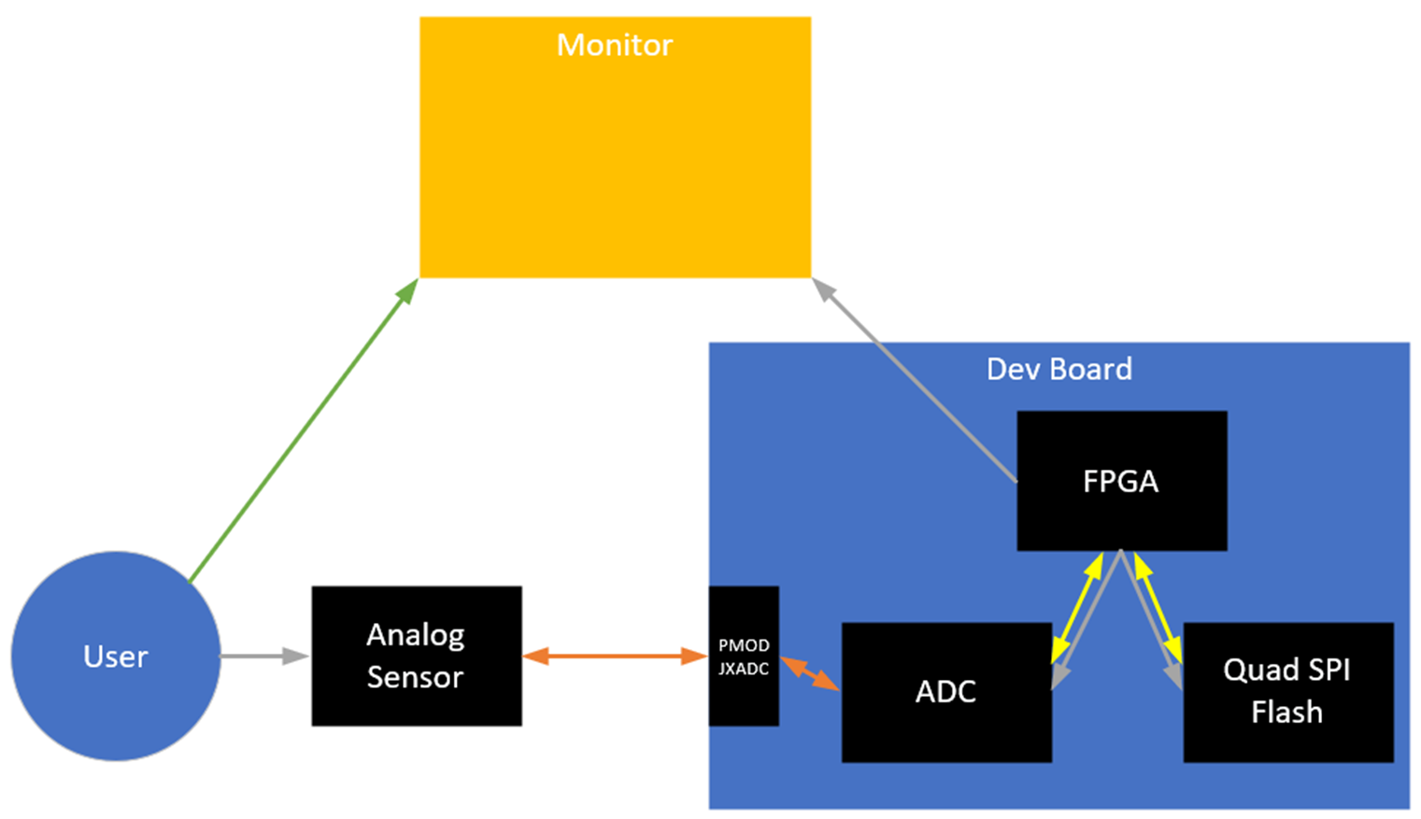
High Level Diagram

